Slide 1
LYNX PRECISION PRODUCTS
GLOBAL CONTRACT MANUFACTURING CO.
Machine Specifications

Slide 2
Table of Contents
Turmatic L 2530 Laser Cutter
YCM 106 CNC
CNC Machine
HB 16 Balancing Machine
A75 Tube Bender
QC12Y-8*3200 Shear
WC67Y-100/3200 Press Brake
Page 3
Page 4
Page 5
Page 6
Page 7
Page 8
Page 9

Slide 3
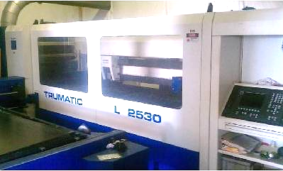
Turmatic L 2530
Laser cutter
 | TC L 2530
Control | SINUMERIK 840D-Based TRUMPF CNC Control
Electrical Loads1 | with TFL 2000 |  |  |  | 55 kVA
 | with TFL 2700 |  |  |  | 63 kVA
 | with TFL 3200 |  |  |  | 65 kVA
 | with TFL 4000 |  |  |  | 80 kVA
Fuses2 (at 400V) | with TFL 2000 |  |  |  | 80 A
 | with TFL 2700 |  |  |  | 100 A
 | with TFL 3200 |  |  |  | 100 A
 | with TFL 4000 |  |  |  | 125 A
Compressed Air Consumption | (required volume rate of flow based
 | on ISO 1217 or DIN 1945) |  |  |  | 33m²3/h=550 I/min
Drives |  |  |  |  | maintenance-free, 3-phase AC servo motors
 | X,Y,Z axes
Speed | Max. Positioning Speed
 | Parallel to axis |  |  |  | 60 m/min
 | Simultaneous |  |  |  | 85 m/min
Accuracy | Smallest programmable increment |  |  |  | 0.01 mm
 | Positioning accuracy² |  |  |  | ±0.1 mm
 | Repeatablility² |  |  |  | ±0.03 mm
Max Laser Power in CW Mode | TFL 2000 |  |  |  | 2000 W
 | TFL 2700 |  |  |  | 2700 W
 | TFL 3200 |  |  |  | 3200 W
 | TFL 4000 |  |  |  | 4000 W
Speed | with TFL 2000 |  |  |  | 12 mm
 | with TFL 2700 |  |  |  | 15 mm
 | with TFL 3200 |  |  |  | 20 mm
 | with TFL 4000 |  |  |  | 20 mm
 | TC L 2530
Total Weight | Without Pallet Changer |  | 7300kg
 | With Pallet Changer |  | 8450kg
Working Range | in X axis |  | 2500mm
 | in Y axis |  | 1250mm
 | in Z axis |  | 115mm
Overshoot Range | in X axis |  | -16 - +88
 | in Y axis |  | -16 - +64
 | in Z axis |  | -2 - +16
Max. Travel Range | in X axis |  | 2588mm
 | in Y axis |  | 1305mm
 | in Z axis |  | 118mm
Travel of Lift Door
 |  |  | 630mm
 |  | without pallet changer | with pallet changer
Dimensions | Length | approx. 6500mm | approx. 6500mm
 | Width | approx. 2500mm | approx. 4500mm
 | Height | approx. 2000mm | approx. 2000mm

Slide 4
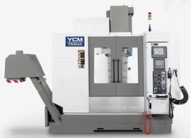
YCM 106 CNC
Machine
SPINDLE
Spindle Speed | 45~8,000rpm
Spindle Power | 5.5/7.5/11kW
Spindle Taper | BT40
Front Bearing Diameter | ø70mm
TRAVEL
X-axis Travel | 1,020mm
Y-axis Travel | 600mm
Z-axis Travel | 600mm
Distance Between Spindle Nose & Table Top | 80~680MM
Distance From Spindle Center to the Sheet Metal Front | 617mm
TABLE
Table Size | 1,120 x 600mm
No. T-Slots X Size X Pitch | 5 x 18mm x 100mm
Max. Load on Table | 800kg
FEEDRATE
Rapid Feedrate X/Y/Z | 30/30/24 m/min.
Cutting Feedrate | 1~10,000mm/min.
ACCURACY
Positioning | 0.003mm/300mm
Repeatability | ±0.003mm
ATC
Tool Magazine Capacity | 24T
Max. Tool Weight | 6kg/pc
Broach Treat Spec | MAS-P40T-1
Max. Tool Size | 90mm x 300mm
Max Tool Dimensions (Without Adjacent Tools) | ø140mm
Tool Changer Method | Arm Type
Tool Selection Method | Random
GENERAL
Pneumatic Supplier | 5.5kg/cm²
Power Cunsumption | 24kVA (25kVA)
Machine Weight | 6,500kg

Slide 5
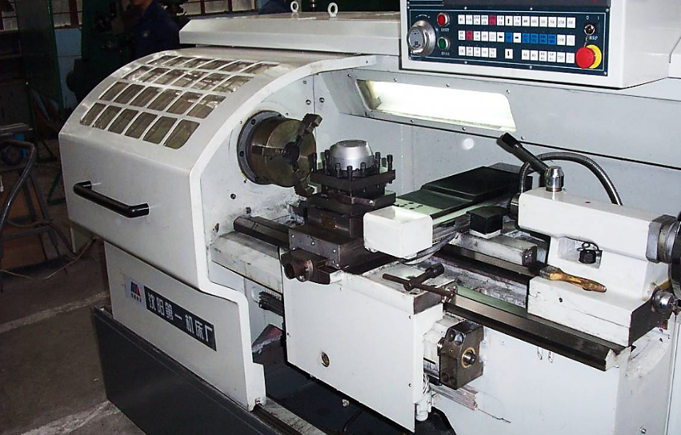
CNC
Machine
item | unit | spec
Max. Turning Diameter of Lathe bed | mm | Φ360
Max. Length of Workpiece | mm | 350
Max. Cutting Length | mm | 250
Max. Turning Diameter of Slip Plate | mm | Φ180
Max. Cutting Length of Slip Plate | mm | Φ180
Bore Diameter of Main Spindle | mm | Φ53
Spindle Speed Range | r/min | 200-3000
Cutter Frame | - | 4 positions
Ripit Move Speed X/Z | m/min | 3.8/7.6
Cutter Install Dimension | mm | 20
Main spinder Diameter of Lathe End | mm | Φ55
Bore Tapper of Main Spinder of Lathe End | - | 莫氏4#
Sleeve Travel of Lathe End | mm | 140
X Axis Travel | mm | 220
Z Axis Travel | mm | 260
X/Z Axis Re Orient Precision | mm | 0.007/0.01
Main Motor Power | kW | 变频5.5
Net Weight | kg | 1750
Gross Weight | kg | 3150
Lathe Dimension (L x W x H) | mm | 2060×1230×1609
NC CONTROL SYSTEM | - | FANUC 0i-mate
Machining Precision | - | IT6-IT7
Surface Roughness of Workpiece | μm | Ra1.6

Slide 6
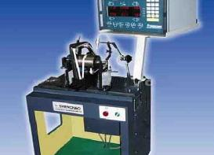
HB16 Balancing Machine
Work Piece Weight Range | kg | 0.5-16
Max. Workpiece Diameter | mm | 360
Range of Two Support Spinder | mm | 40-420
Diameter Range of Support Spinder | mm | 5-40
Diameter of Drive Belt | 10-120 | 10-120
Balance Speed | rpm | 680/1220
Motor Power | kw | 0.25
Min. Balance (emar) | gmm/kg | ≤0.3
Not Nalance Release (URR) |  | ≥90％

Slide 7
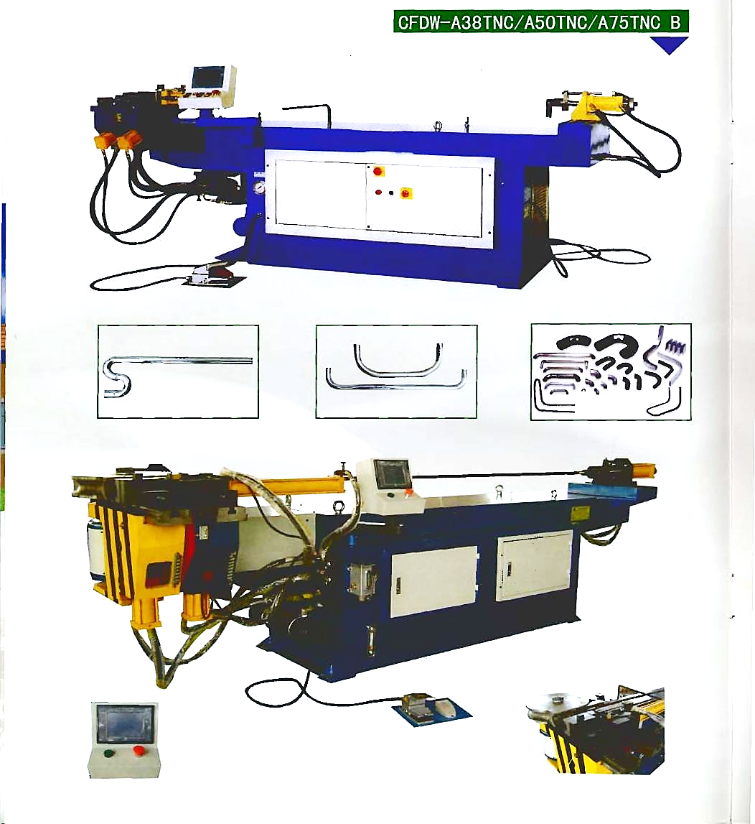
A75 Tube Bender
Technical Spec
Max. Bend Spec | mm/inch | 75/2.95
Max. Tube Thickness | mm/inch | 2.5/0.1
Bend Radius Range | mm/inch | 60-350/2.36-13.78
Max. Bend Angle Range | ° | 190
Max. Mandrel Valid Distance | mm/inch | 2600/102.36
Worktable Height | mm/inch | 1100/43.31
Tooling Center Height | mm/inch | 50/1.97
Fixture Move Distance | mm/inch | 90/3.54
Mandrel Move Distance | mm/inch | 75/2.95
Bend Speed | °/sec | 20
Bend Precision | ° | 0.15
Hydraulic System Motor | kw | 7.5
Total Power | kw | 7.5
Oil Box Capacity | L | 180
Max. Pressure | Mpa | 17
Machine Width | mm/inch | 950/37.4
Machine Height | mm/inch | 1250/49.21
Machine Length | mm/inch | 3600/141.73
Machine Weight | kg | 2600

Slide 8
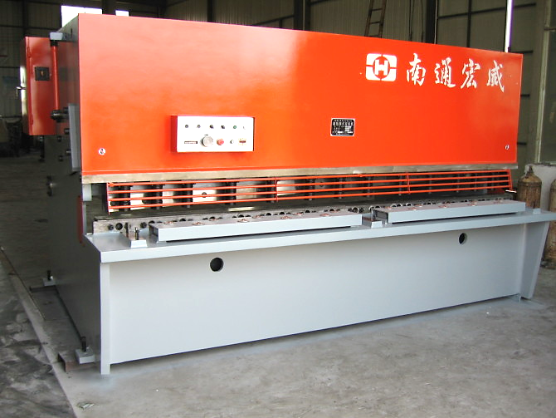
QC12Y-8*3200 Shear
Technical Spec | unit
Cutting Size (TxW) | mm | 8x3200
Shear Angle | ° | 1°30'
Strokes | Min⁻¹ | 10
Adjusting Range of Backgauge | mm | 20-600
Main Motor Capacity | KW | 7.5
Outline Dimensions (LxWxH) | mm | 3880x1830x1720

Slide 9
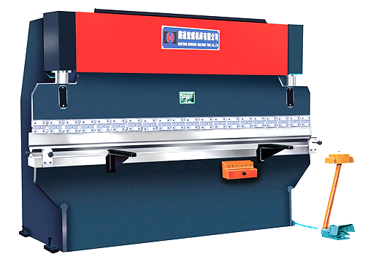
WC67Y-100/3200 Press Brake
Technical Spec | unit
Nominal Force | KN | 1000
Length of Table | mm | 3200
Distance Between Uprights | mm | 2550
Throat Depth | mm | 320
Ram Stoke | mm | 150
Stroke Adjustment | mm | 100
Max. Opening Height | mm | 420
Strokes | min⁻¹ | 8
Main Motor Capacity | KW | 7.5
Outline Dimensions (LxWxH) | mm | 3260x1465x2600

